Slide 1
Increasing Returns to Scale at Volkswagen
CASE STUDY
BASIC ECONOMICS
FABRA Pilar, SANCHEZ Diana, KUMAR Sonu, ILLESCAS Leandro
08/OCT/2020

Slide 2

INTRODUCTION OF THE CASE
VW is the engine manufacturer.
Existing arrangements between VW and VOLVO —> VW installs or modifies engines in VOLVO cars.
This is an increasing return to scale.
BENEFITS
VW increases productivity, with small increase in inputs.
VOLVO sees lower engine costs.

Slide 3
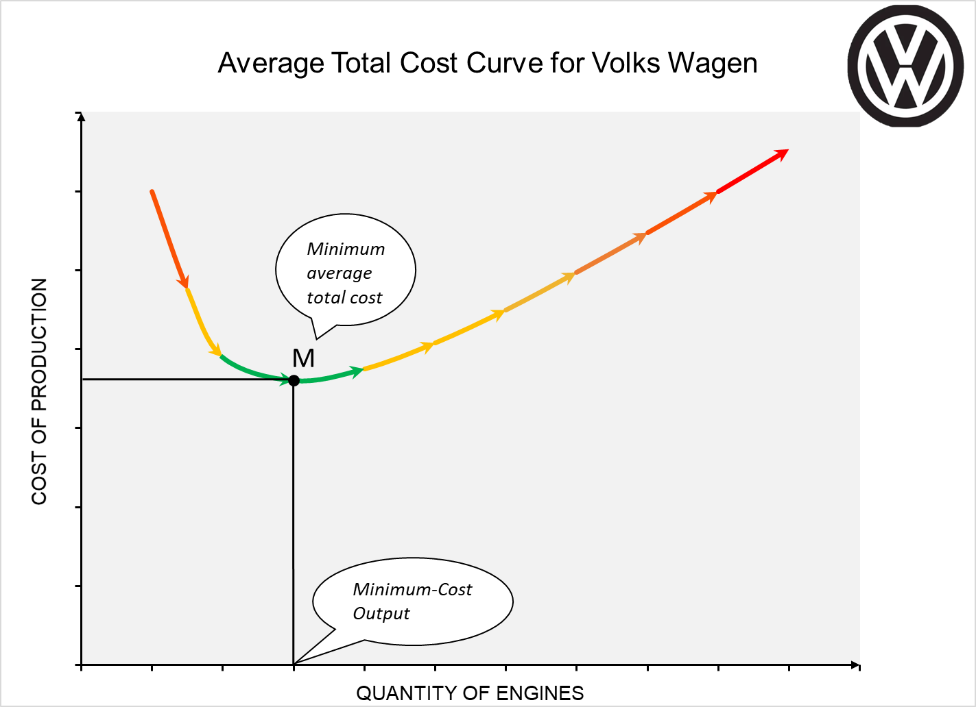
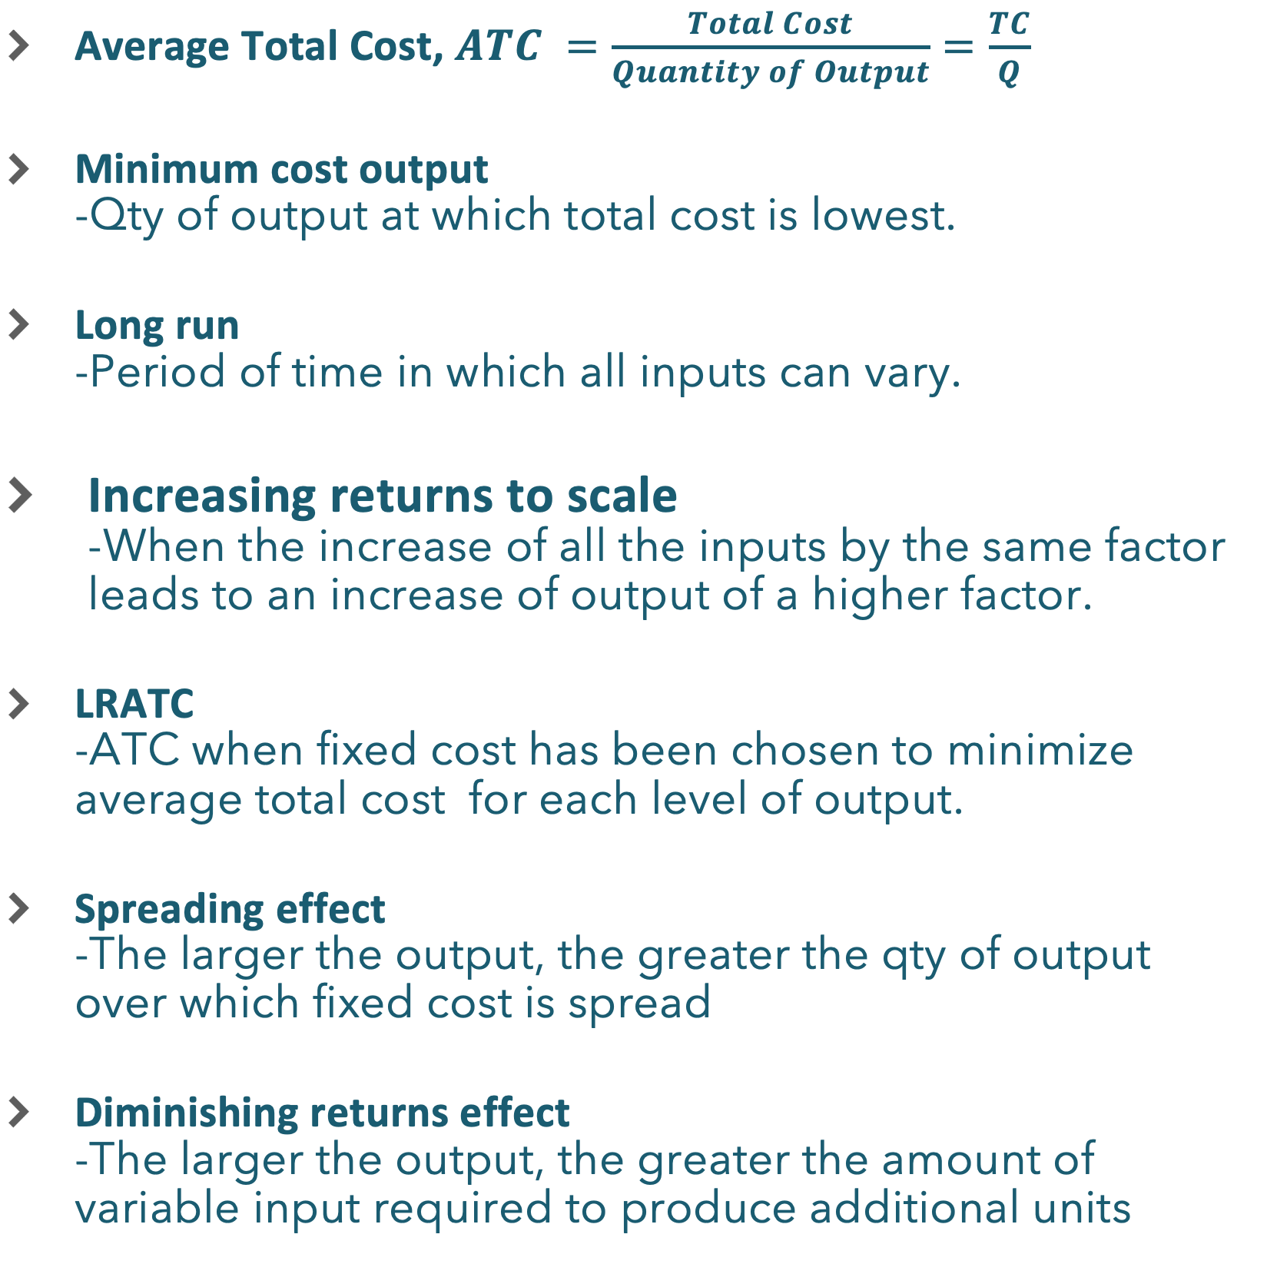
Economic terms and notions
Average Total Cost, $ATC =\frac{Total Cost}{Quantity of Output}=\frac{TC}{Q}$
Minimum cost output -Qty of output at which total cost is lowest.
Long run -Period of time in which all inputs can vary.
Increasing returns to scale -When the increase of all the inputs by the same factor leads to an increase of output of a higher factor.
LRATC -ATC when fixed cost has been chosen to minimize average total cost for each level of output.
Spreading effect -The larger the output, the greater the qty of output over which fixed cost is spread
Diminishing returns effect -The larger the output, the greater the amount of variable input required to produce additional units
Notes:
Average Total Cost, $ATC =\frac{Total Cost}{Quantity of Output}=\frac{TC}{Q}$
Minimum cost output: Qty of output at which total cost is lowest.
Long run : period of time in which all inputs can vary.
Increasing returns to scale (or economics of scale) : long-run average total cost declines as output increases.
LRATC: ATC when fixed cost has been chosen to minimize average total cost for each level of output. Relationship between output and average total cost when fixed cost has been chosen to minimize average total cost for each level of output.
Spreading effect: the larger the output, the greater the qty of output over which fixed cost is spread, leading to lower average fixed cost.
Diminishing returns effect: the larger the output, the greater the amount of variable input required to produce additional units, leading to higher average variable cost.

Slide 4
CASE ANALYSIS
Why does VW can increase outputs and benefit from it?
Specialization
Big initial investment (Assets)
Reputation
Market Access

